Slide 1

Real-time volume rendering using GPU and semi-automatic transfer function.
Shashank Chandgude (2304656)
Hemanth Nagapudi (2285874)
COSC 6344 Visualization

Slide 2
Background
Real-time volume rendering rapidly generates and displays 3D images, offering quick visual feedback.
Crucial in medical imaging, it dynamically visualizes complex anatomical structures, aiding in diagnosis and treatment planning.
Vital for comprehending intricate 3D datasets in scientific research across diverse fields.
Integral in Computer-Aided Design (CAD), providing dynamic 3D model views and expediting prototyping.
Enhances VR and AR applications by creating immersive simulations and training scenarios.
Used in industries like oil and gas for efficient visualization of subsurface geological structures.
Applied in diverse domains, from flight simulators to educational simulations, for interactive 3D visualization.

Slide 3
We have used gpu based vtkGPUVolumeRayCastMapper() mapper along with vtkColorTransferFunction() for added gpu support.
We then used, vtkPiecewiseFunction() for our opacity function and used a slider input for the opacity scalar points.
This slider changes the opacity for scalar values gives us the following output. We did try for a interactive user input for color transfer function too. But had to work without it due to time constraint.

Slide 4
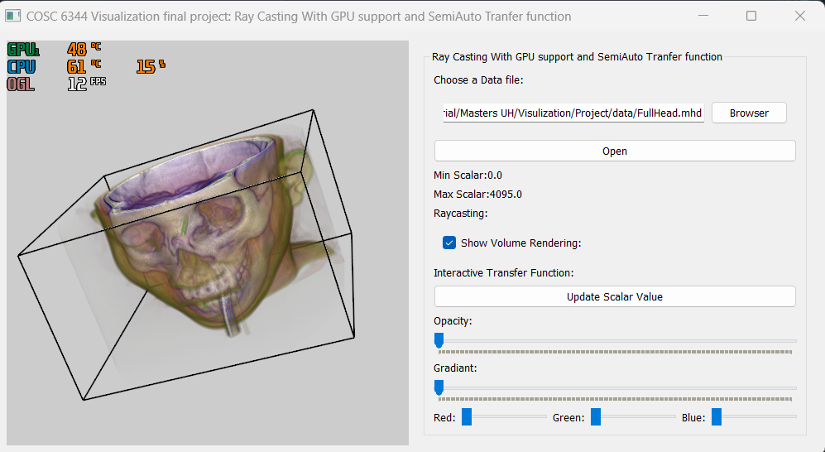

Slide 5
